Slide 1
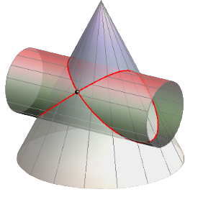
Intersection of Solids
Prepared by:
Er. Bibek Magar
BE in Automobile Engineering
IOE, Thapathali Campus
bibek.magar@thc.tu.edu.np

Slide 2
Intersection of Solids
When the surface of one solid meets that of another, the line(s) along which the two surfaces meet each other is known as the curve(s) of intersection of the surfaces of the two solids.
Similarly, if a hole is cut in a solid the line along which the surface of the hole meets that of the solid is also known as the curve of intersection of the two surfaces.
If a solid completely penetrates another solid, the line along which the two surfaces meet is known as the line of interpenetration or the curve of interpenetration.
In this chapter, the discussion is limited to the cases when a prism, a pyramid, a cylinder, a cone, or a sphere is penetrated by either a prism or a cylinder, or has a prismatic or cylindrical hole.

Slide 3
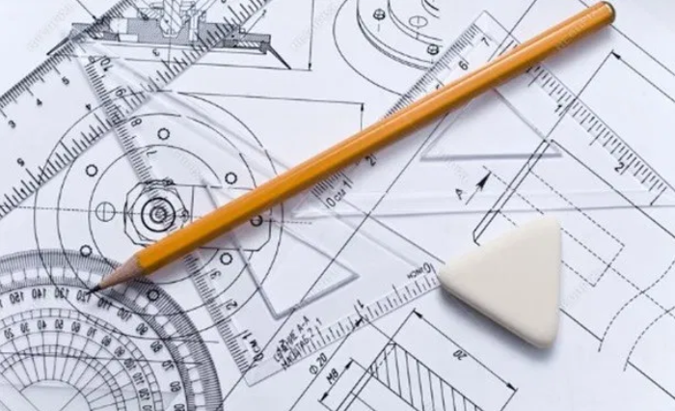
Solved Examples:

Slide 4
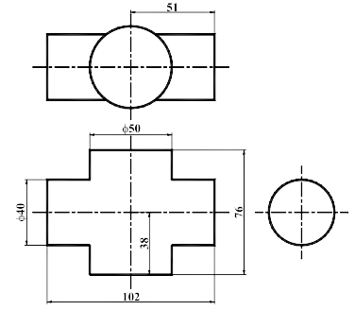
1) Draw the given views of assigned form and complete the intersection.

Slide 5
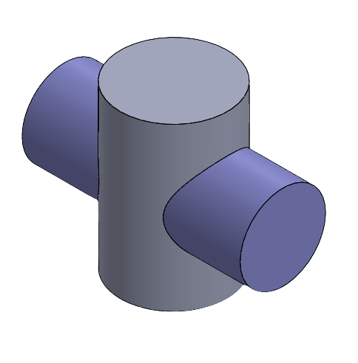
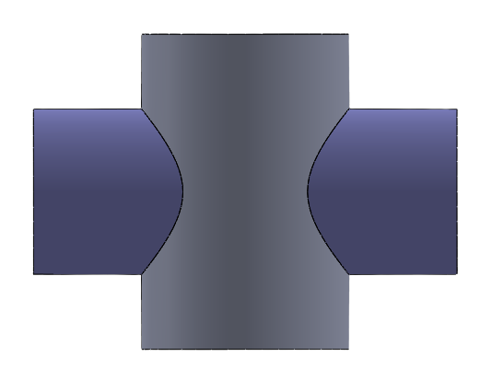
3D Visualization of the solids:

Slide 7
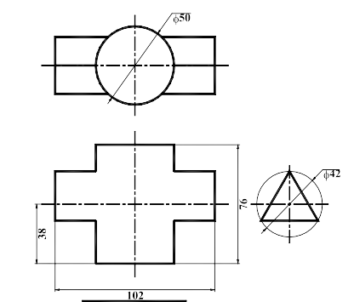
2) Draw the given views of assigned form and complete the intersection.

Slide 8
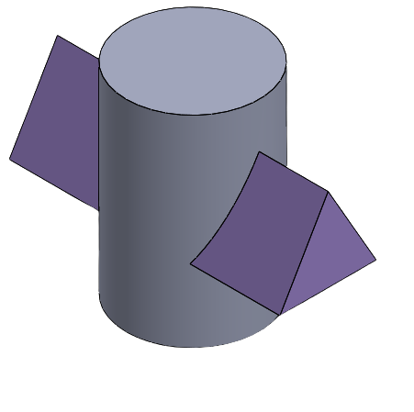
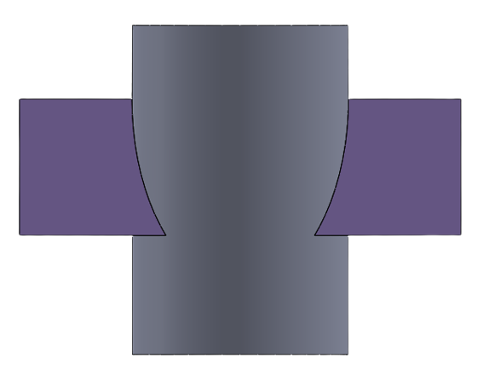
3D Visualization of the solids:

Slide 10
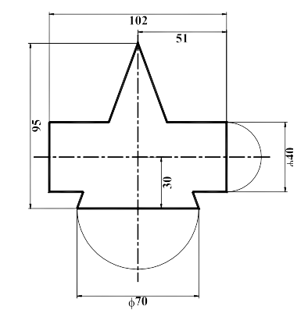
3) Draw the given views of assigned form and complete the intersection.

Slide 11
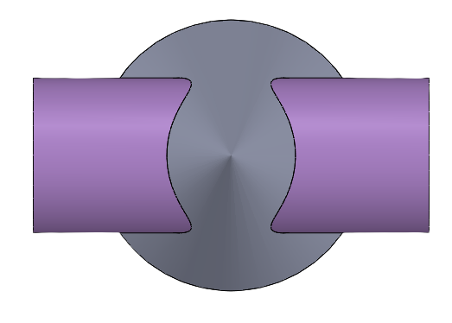
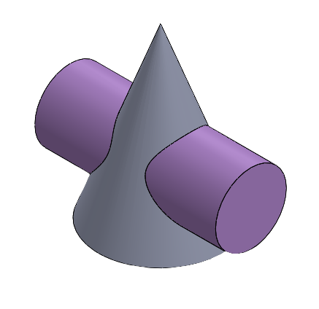
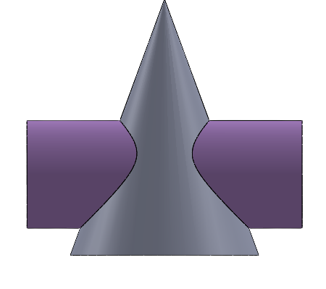
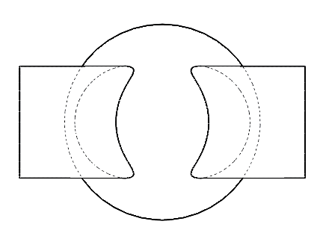
3D Visualization of the solids:

Slide 13
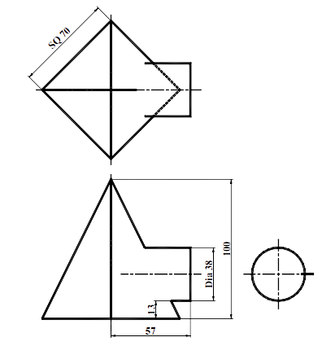
3) Draw the given views of assigned form and complete the intersection.

Slide 14
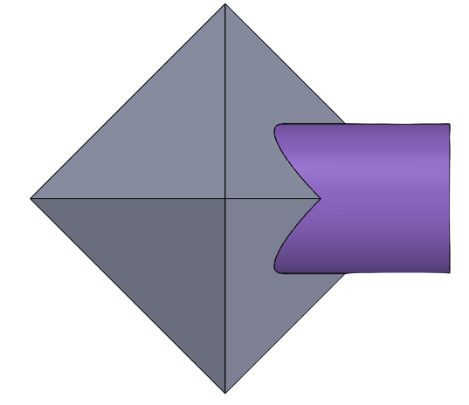
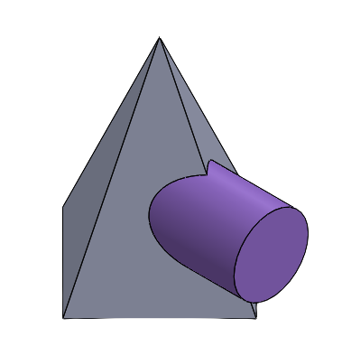
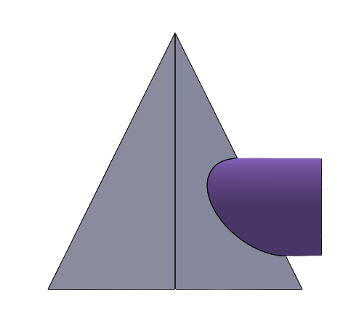
3D Visualization of the solids:

Slide 16
3) Draw the given views of assigned form and complete the intersection.
Ø30
80
25
35
100

Slide 17
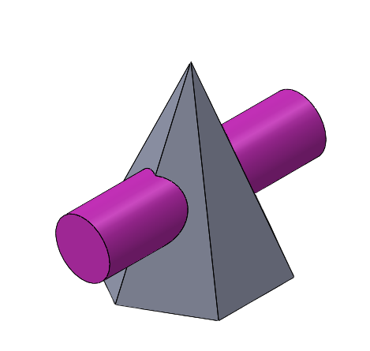
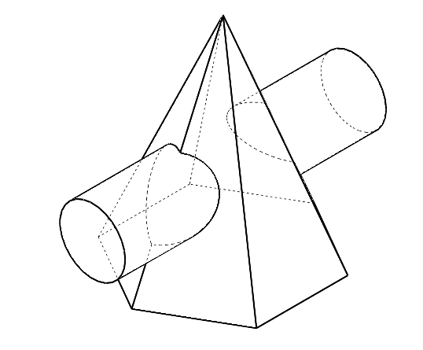
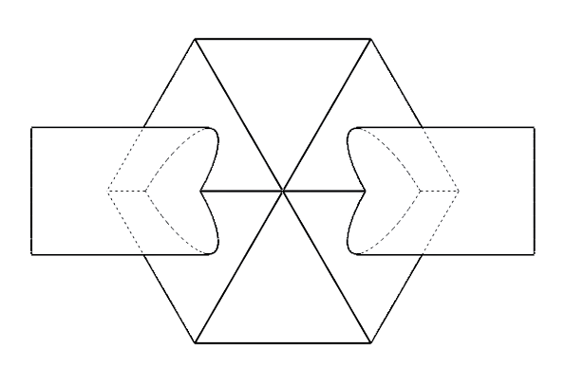
3D Visualization of the solids:

Slide 19
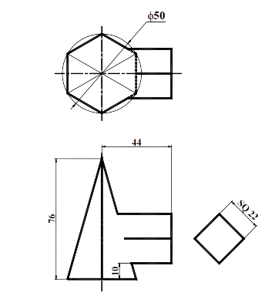
3) Draw the given views of assigned form and complete the intersection.

Slide 20
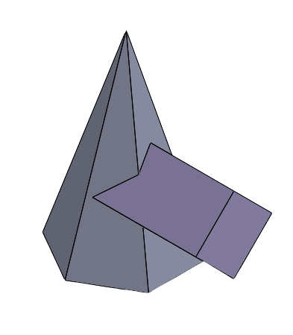
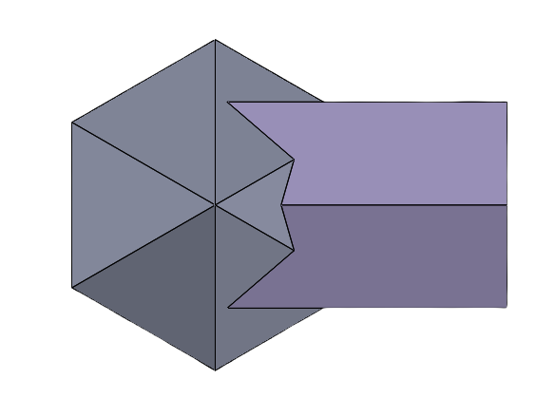
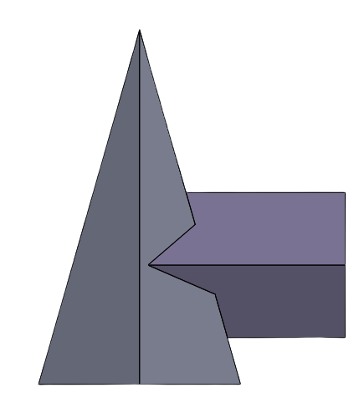
3D Visualization of the solids:

Slide 22
4) Draw the given views of assigned form and complete the intersection.
96.0000
Ø42.0000
4.0000
70.0000
35.0000
56.0000

Slide 23
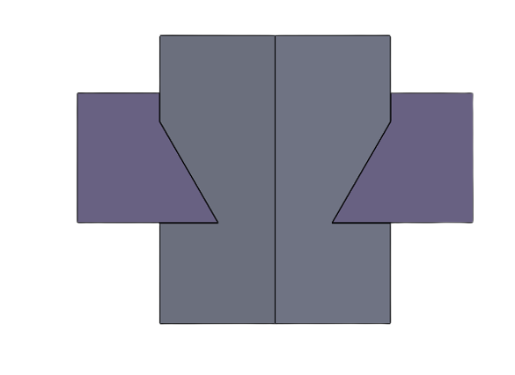
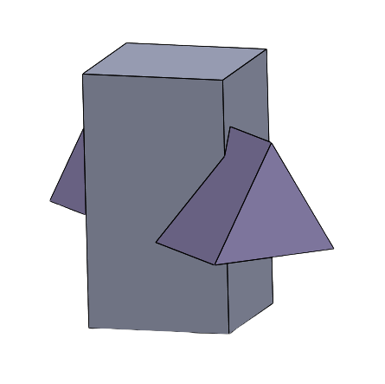
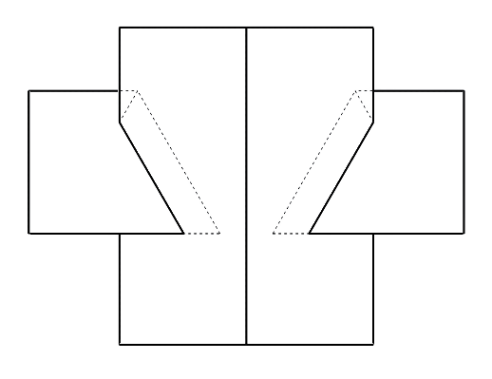
3D Visualization of the solids:

Slide 25
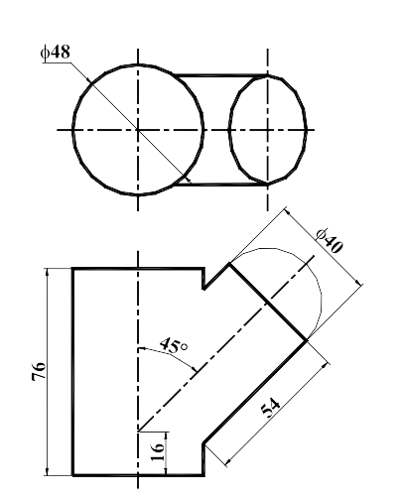
5) Draw the given views of assigned form and complete the intersection.

Slide 26
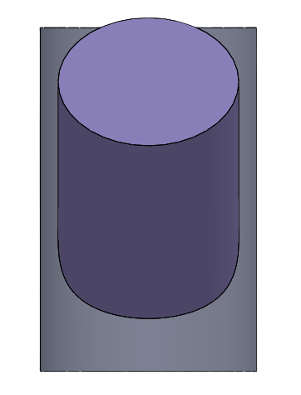
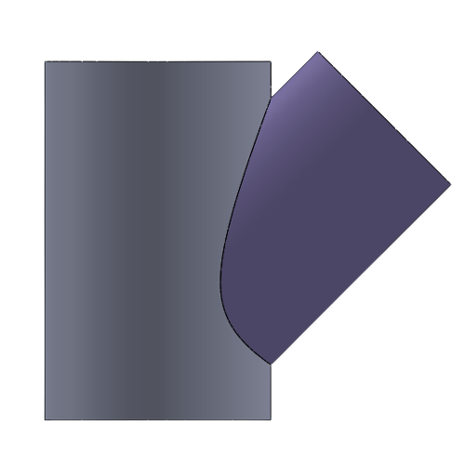
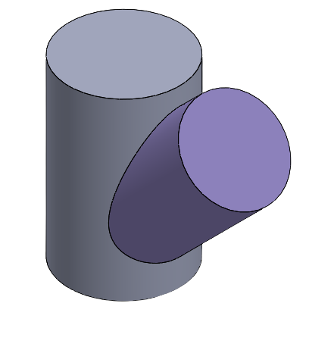
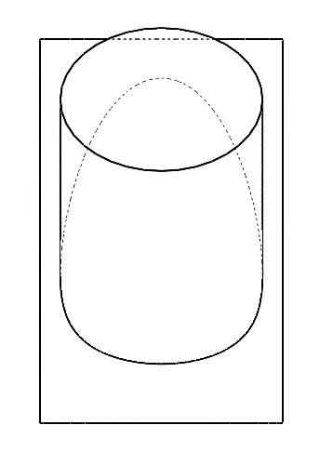
3D Visualization of the solids:

Slide 28
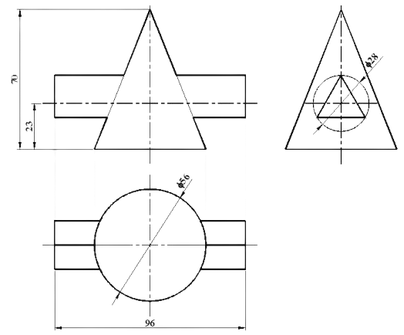
6) Draw the given views of assigned form and complete the intersection.

Slide 29
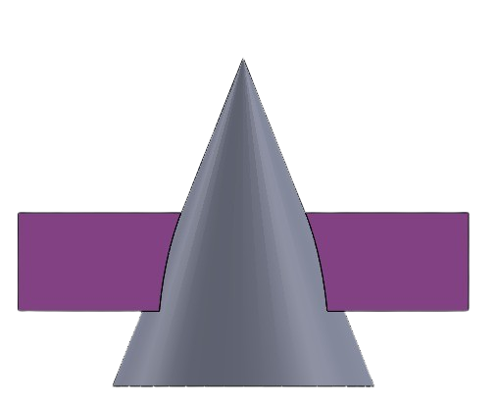
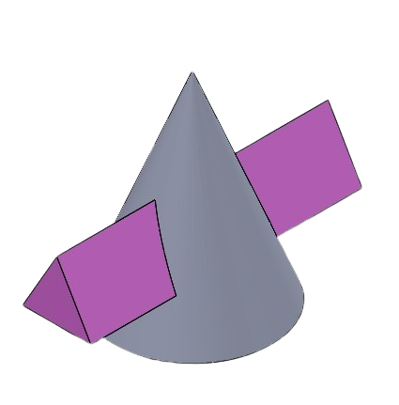
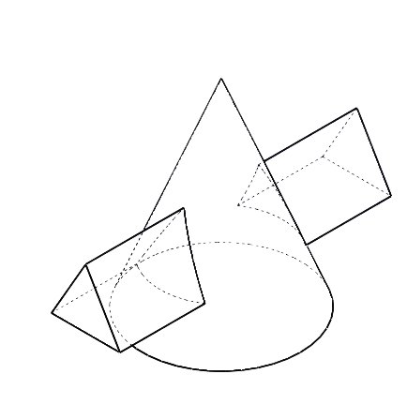
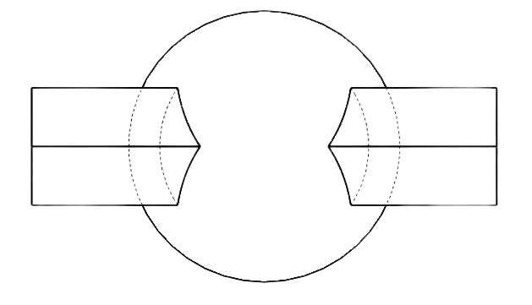
3D Visualization of the solids:

Slide 31

Some more examples of Intersection of Solids

Slide 32
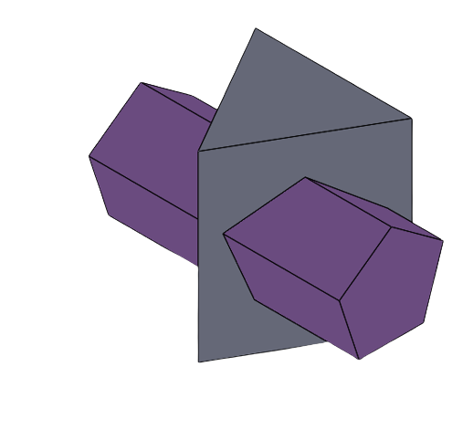
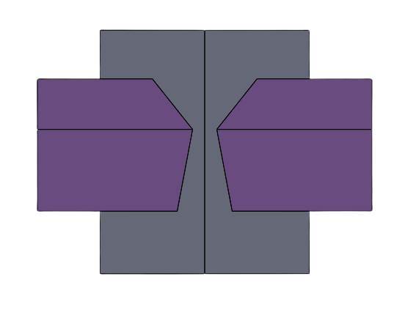
Base Solid: Triangular Prism
Intersecting Solid: Pentagonal Prism

Slide 33
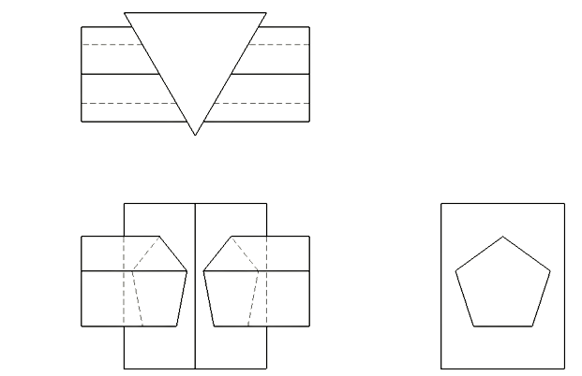

Slide 34
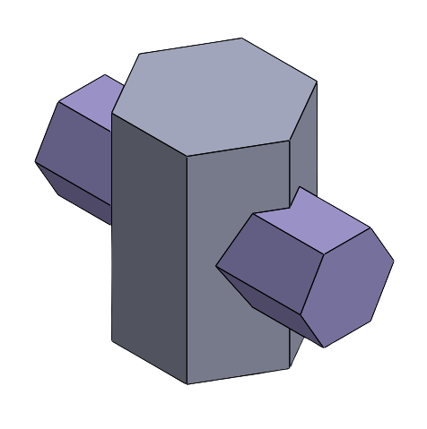
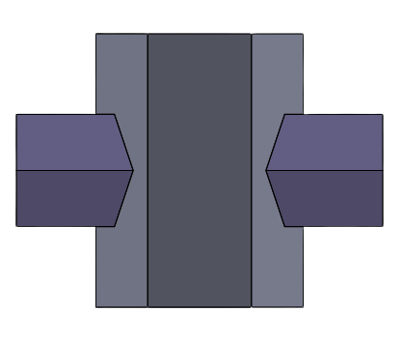
Base Solid: Hexagonal Prism
Intersecting Solid: Hexagonal Prism

Slide 35
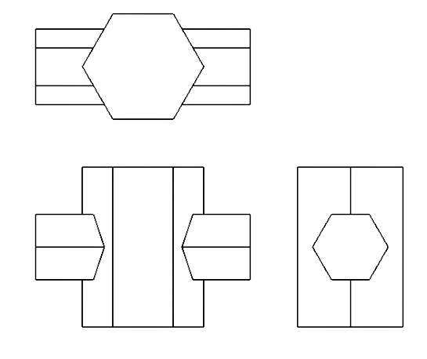

Slide 36
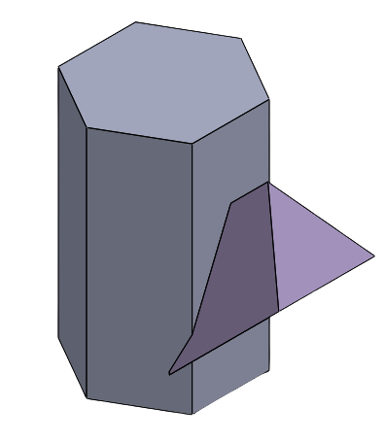
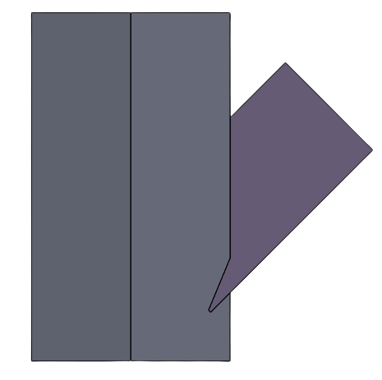
Base Solid: Hexagonal Prism
Intersecting Solid: Triangular Prism

Slide 37
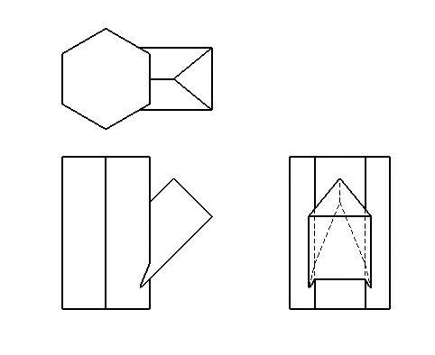

Slide 38


